Slide 1
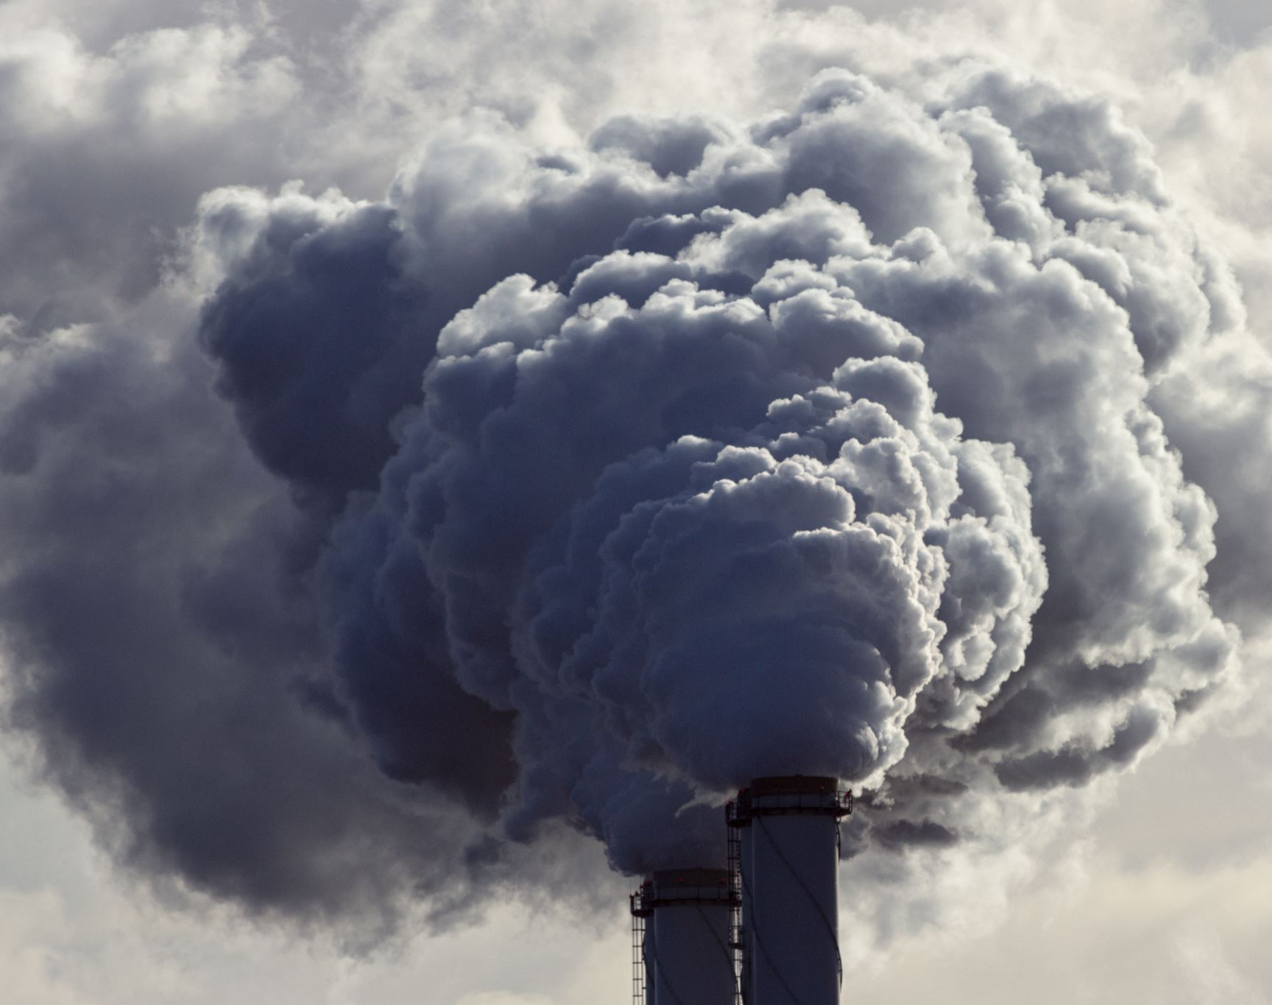
Generating energy from graphite

Slide 2

Introduction: Closed-Loop Carbon Cycle: Graphite Combustion and Regeneration
As the world pushes for more sustainable energy, finding clean, renewable options is more urgent than ever. Traditional sources like hydro, nuclear, and fossil fuels have been reliable, but they come with environmental and safety concerns. This study explores a new solution: a closed-loop Graphite Carbon Cycle System. This system taps into the high energy potential of graphite, using a process that captures CO₂ and converts it back into solid carbon. This almost zero-emission approach could be a scalable and eco-friendly alternative with minimal environmental impact.

Slide 3

The idea
System Description:
Burning Room
CO₂ Collection and Transfer System
Carbon Regeneration Chamber

Slide 4

Burning Room
Heat-Resistant Chamber Walls
Graphite Combustion Platform
Oxygen Injection System
Water-Heating Plate

Slide 5

Water Heating and Steam Generation
A water-heating plate above the combustion area absorbs excess heat.
This heat converts water into steam, which is directed toward a turbine.
Turbine Rotation for Electricity Generation
Steam drives the turbine, producing electricity in the process.
After powering the turbine, steam is condensed and recycled in a closed-loop system for efficiency.

Slide 6

CO₂ Collection and Transportation System
Inclined Ceiling and Channeling of CO₂
One-Way Valve

Slide 7

Carbon Regeneration Room
Carbon Regeneration Chamber
High-Temperature Reactor Core
Solids Carbon Exit Port
Water Vapor Exhaust and Condensation System
Hydrogen
Cobalt

Slide 8

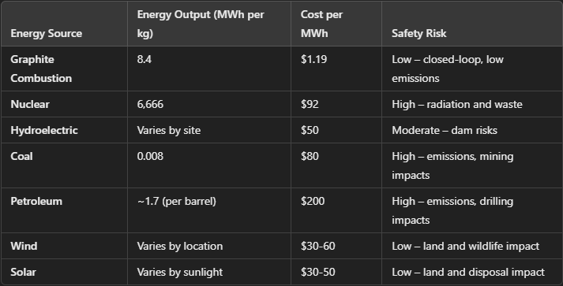
Comparing to other sources of energy

Slide 9

Conclusion
The Graphite Carbon Cycle System offers a groundbreaking approach to sustainable energy, using high-density graphite in a closed-loop process that regenerates CO₂ into solid carbon. This system is safe, cost-effective, and low in emissions, making it

Slide 10

Thank you

